Slide 1
Complete and Submit the Budget Forecast Report (BFR)

Slide 2
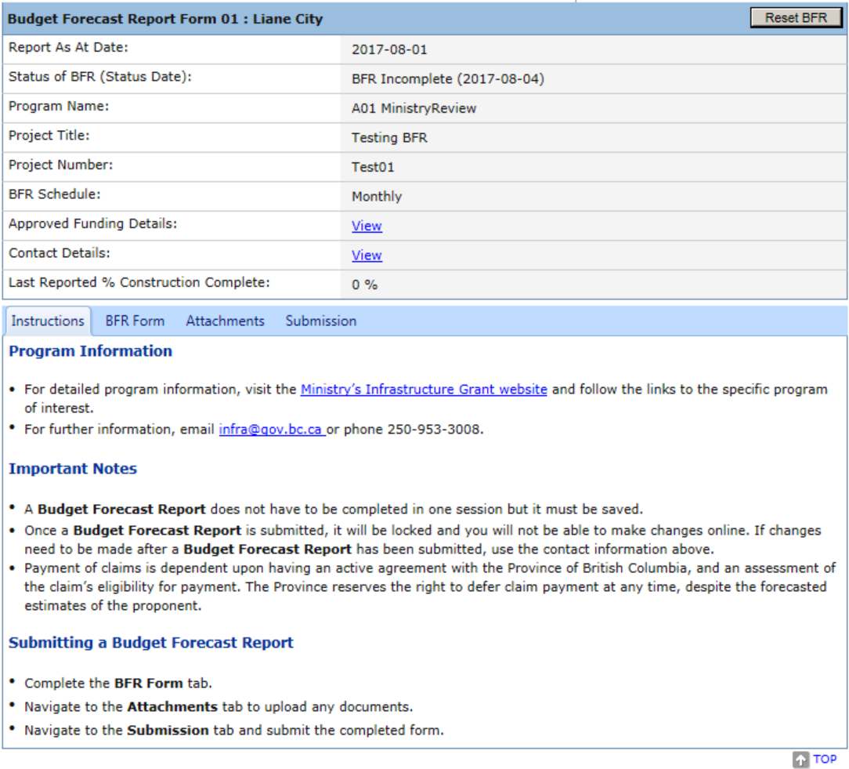
The New BFR Report opens to a summary page.
For a review of this page please see the Power Point titled, “Create New BFR”
To complete the BFR, click on BFR Form Tab.

Slide 3
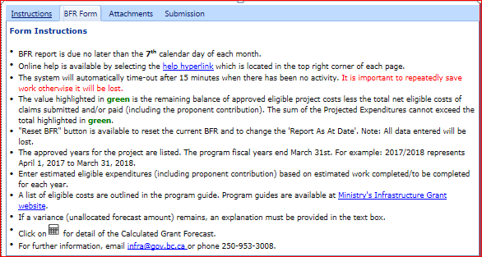
The BFR Form tab opens with Form Instructions displayed at the top of the page. Please review the Form Instructions for important information.
Of particular importance is the bullet:
The value highlighted in green is the remaining balance of approved eligible project costs less the total net eligible costs of claims submitted and/or paid (including the proponent contribution). The sum of the Projected Expenditures cannot exceed the total highlighted in green.

Slide 4
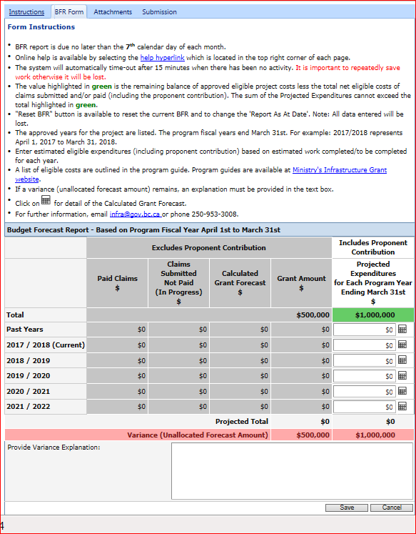
BFR Form

Slide 5
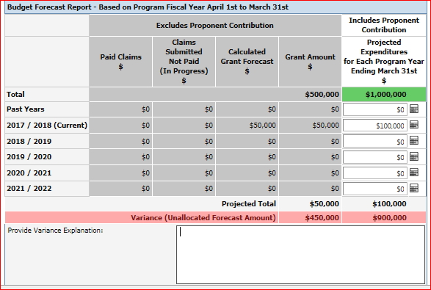
Enter the Projected Expenditures for Each Program Year Ending March 31st.
The Projected Expenditures includes your Share as well as the Provincial Share and the Federal Share (if applicable).
The system calculates values as they are entered on each line. You will see a scrolling icon to reflect this calculation process. Click on the next dollar value box to proceed with your entry.
Click on the calculator icon to see how the calculations are derived.

Slide 6
To review the Projected Expenditures calculation example.
Click on the calculator icon .
$100,000 was entered in the 2017/2018 Projected Expenditures field.
The program for this project states that the Proponent pays 50% (column A) of the Total Net Eligible Costs, the Province pays 25% (Column B) and the Federal Government pays 25% (Column C). Cost shares are determined by the program and identified in the project shared cost agreement.
The $100,000 entry is displayed as Proponent amount $50,000 (50%), Provincial amount $25,000 (25%) and the Federal Government amount $25,000 (25%)
The Calculated Grant Forecast is the sum of the Provincial Amount plus the Federal Government Amount. ($50,000)

Slide 7
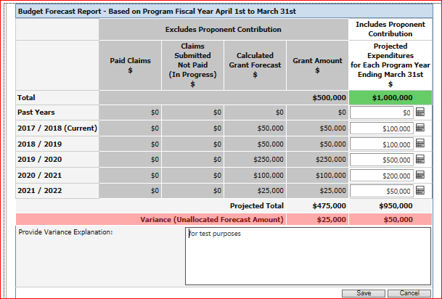
Enter values for the Projected Expenditures for Each Program Fiscal Year April 1st to March 31st
If a variance (unallocated forecast amount) remains, an explanation must be provided in the text box. For example, a variance may occur if the full grant amount is not expected to be reimbursed.

Slide 8
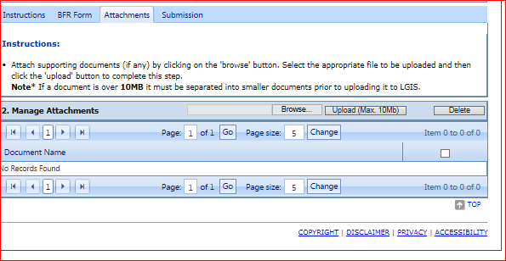
Once all Projected Expenditures for Each Program Year have been entered and saved, you may add attachments to support your projections although they are not necessary unless requested.
Click Attachments Tab, click Browse to find the document you want to attach.
Click Upload Note* that the maximum file size is 10mb

Slide 9
The document that is uploaded will appear in the Document Name grid
The BFR is now ready to Submit to the Ministry for review.

Slide 10
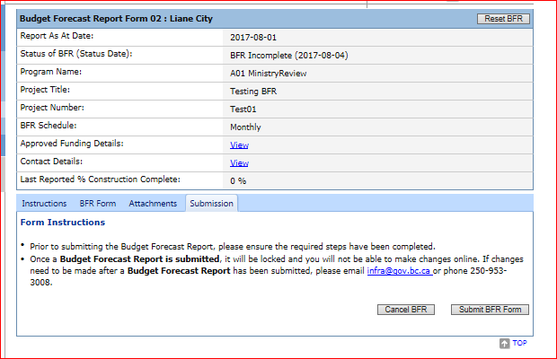
Click on the Submission Tab of the BFR and review the instructions. The BFR form will not be editable after it has been submitted.

Slide 11
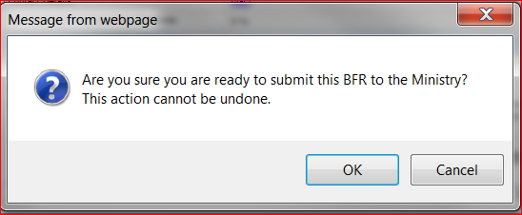
The following alert message will appear once Submit BFR has been initiated. It is a confirmation that you are ready to submit the BFR and that the action cannot be undone.
Click OK

Slide 12
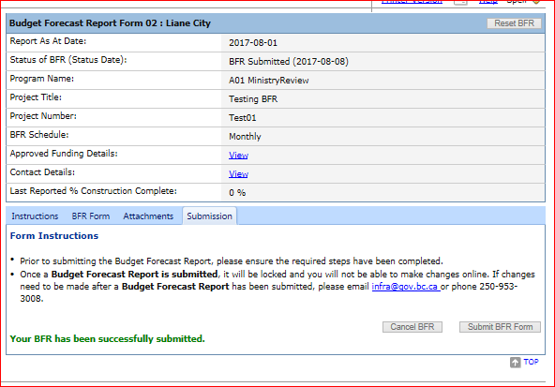
Confirmation that the BFR has been successfully submitted will display and the BFR status will display as BFR Submitted.

Slide 13
LGIS Website : https:/www.localgovernment informationsystem.gov.bc.ca/LGIS For assistance please contact: Phone: (250) 953-3008 Email : infra@gov.bc.ca

